Slide 1
IBM University Engagement Project Submission
“Exploring the Power of Agentic AI with IBM Granite and LangFlow”

Slide 2

Project Tile – [AI-Powered Social Media Agent for Intelligent Content Strategy and Analytics]
Domain of Project – [Social Media Analytics / Digital Marketing / AI]
Student Name | Recent Passport Photo | Email ID | Mobile number [WhatsApp]
Dipika Dahyabhai Prajapati |  | dipika.kothariya@bvmengineering.ac.in | 8866337810

Slide 3
Problem Statement: Social Media Agent
The Challenge
Brands, influencers, and organizations face difficulties in managing the fast-changing social media environment. Content trends change rapidly, audience sentiment shifts continuously, and competitor strategies are difficult to monitor.
Managing data from multiple platforms results in:
Scattered social media insights
Missed engagement opportunities
Difficulty identifying trending topics
Inefficient content planning
Lack of real-time audience understanding

Slide 4
Technology Used
Technology Approach Used: LangFlow + IBM watsonx.ai + Granite Models
Technologies Used:
LangFlow → Visual workflow creation and multi-agent orchestration
IBM watsonx.ai → AI model deployment, governance, and enterprise AI capabilities
IBM Granite Models → Natural language understanding, reasoning, and content generation
RAG (Retrieval Augmented Generation) → Retrieve social media trends and external knowledge before generating responses
Vector Database (FAISS / Chroma) → Store and retrieve social media knowledge efficiently

Slide 5
Proposed Solution -
AI-Powered Social Media Agent
The proposed solution is a multi-agent AI system that helps brands and creators monitor, analyze, and improve their social media presence.
The system uses IBM Granite models with LangFlow orchestration to provide intelligent content recommendations and real-time insights.
Key Agents:
1. Social Data Collection Agent
Collects posts, comments, hashtags, competitor data
2. Sentiment Analysis Agent
Understands audience reactions
Classifies positive, negative, and neutral sentiment
3. Content Generation Agent
Creates captions, posts, campaign ideas
4. Trend Prediction Agent
Identifies upcoming trends
Suggests hashtags and posting time
5. Analytics Agent
Generates reports and performance insights

Slide 6
Langflow component Used -
Chat Input
User enters:
Marketing goals
Brand details
Content requirements
2. IBM watsonx AI Agent
Processes user requests
Uses IBM Granite model for reasoning and generation
3. IBM Granite Model Granite-4.0-8B-Instruct
Used for:
Content generation
Sentiment understanding
AI recommendations
4. File Component
Stores:
Brand information
Previous campaigns
Social media datasets
5. Retriever / Vector Store
Retrieves trending information and stored knowledge
6. Chat Output
Displays:
Generated posts
Insights
Recommendations

Slide 7
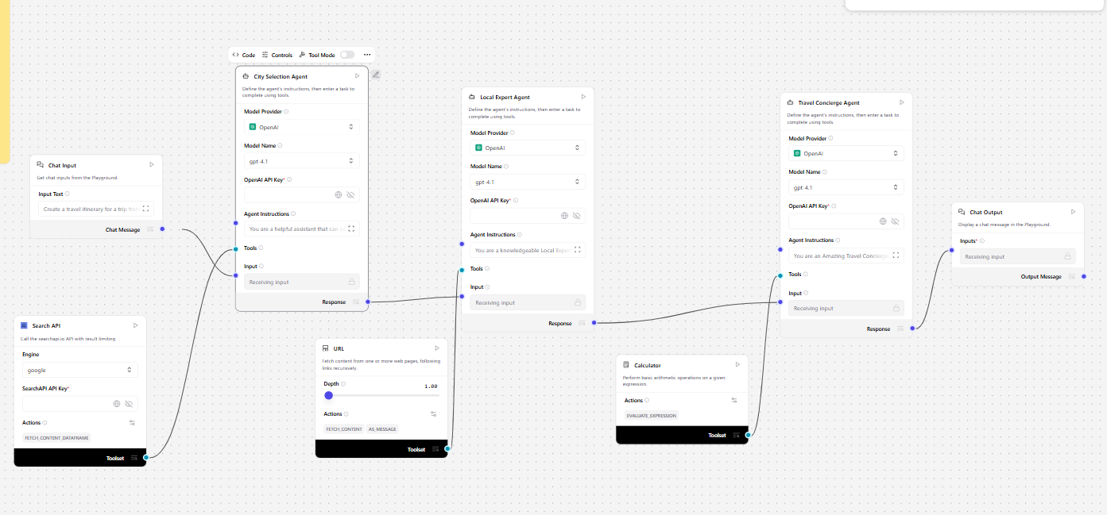
Langflow workflow -

Slide 8

Architecture blueprint

Slide 9

Role of Agentic AI in the solution
Agentic AI enables the system to work as an autonomous digital marketing assistant.
Benefits:
Autonomous Decision Making
Agents analyze data and recommend actions
Context Awareness
Understands brand identity and audience behavior
Multi-Agent Collaboration
Different agents perform specialized tasks
Real-Time Adaptation
Updates recommendations based on changing trends
Goal-Oriented Actions
Helps improve engagement and campaign performance

Slide 10
Technology Used
LangFlow
Builds and manages AI agent workflows visually
IBM Granite Model
Generates content
Performs reasoning
Provides intelligent recommendations
IBM watsonx.ai
AI deployment platform
Model management and governance
RAG Pipeline
Retrieves latest social media knowledge
Vector Database
Stores social media insights for semantic search

Slide 11
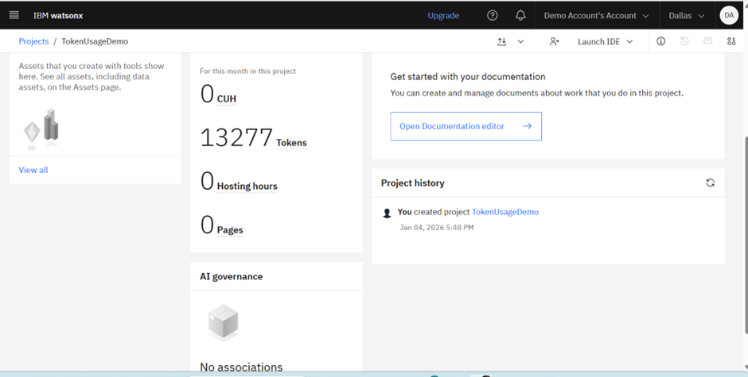
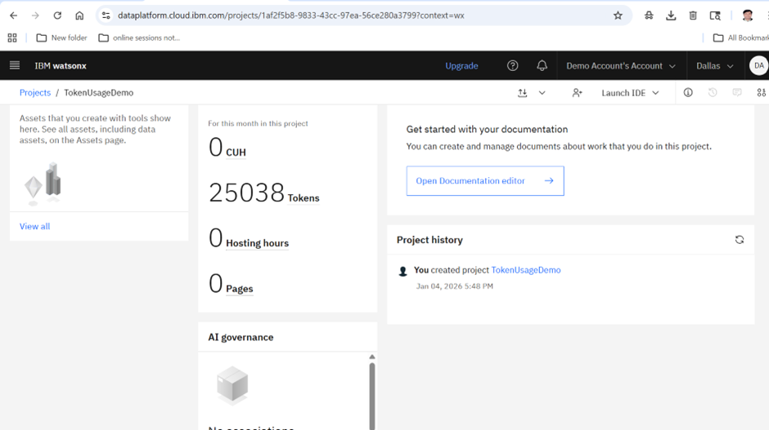
Token Usage
11,761 token are used
·
·
·

Slide 12
Novelty and Uniqueness
Why This Solution is Different?
Multi-Agent Intelligence
Multiple AI agents collaborate for better decisions.
Real-Time Social Media Intelligence
Analyzes trends and audience behavior continuously.
Predictive Analytics
Forecasts:
Trending hashtags
Engagement patterns
Content opportunities
Multimodal Support
Supports:
Text
Images
Voice inputs
Personalized Content Strategy
Creates content based on brand goals and audience.

Slide 13
Git Hub Link
Github URL – https://github.com/DIPIKA1301/AI-Marketing-Assistant-Agent
·
·
·

Slide 14
Future Scope
1. Advanced AI Content Creation
Integration with:
AI image generation
2. Voice-Based Social Media Assistant
Users can:
Give voice commands
3. Real-Time Platform Integration
Future integration with:
Social media APIs
4. Advanced Predictive Marketing
AI can predict:
Viral content opportunities
·
·
·

Slide 15


